Slide 1

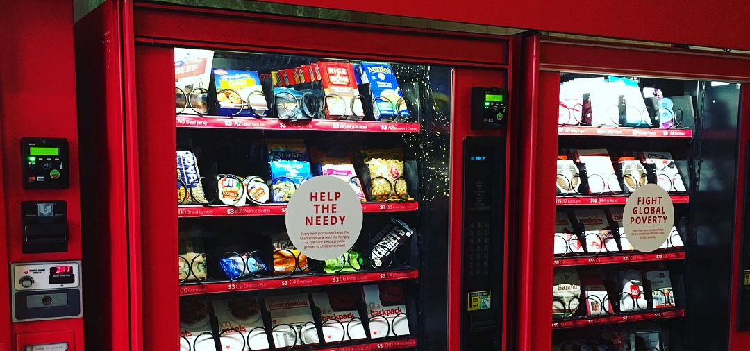


Final Project: Vending Machine IC
Fabricio Zuniga
VLSI Design
Fall 2020

Slide 2
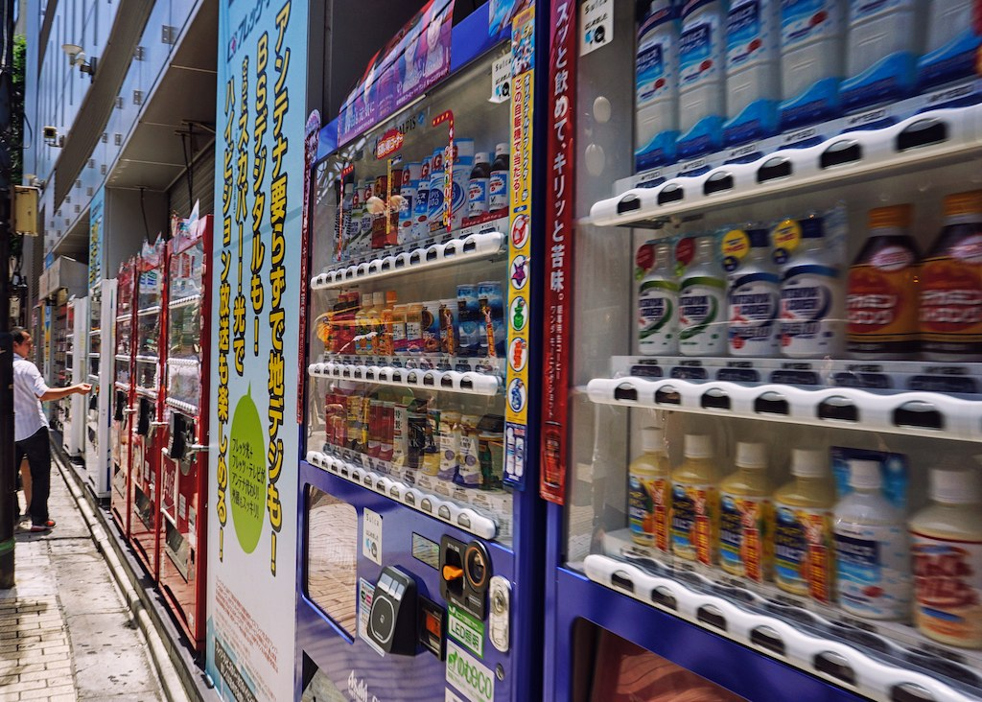
Outline
Dated back to Ancient Greece
Found all over the world
Convenience

Slide 3
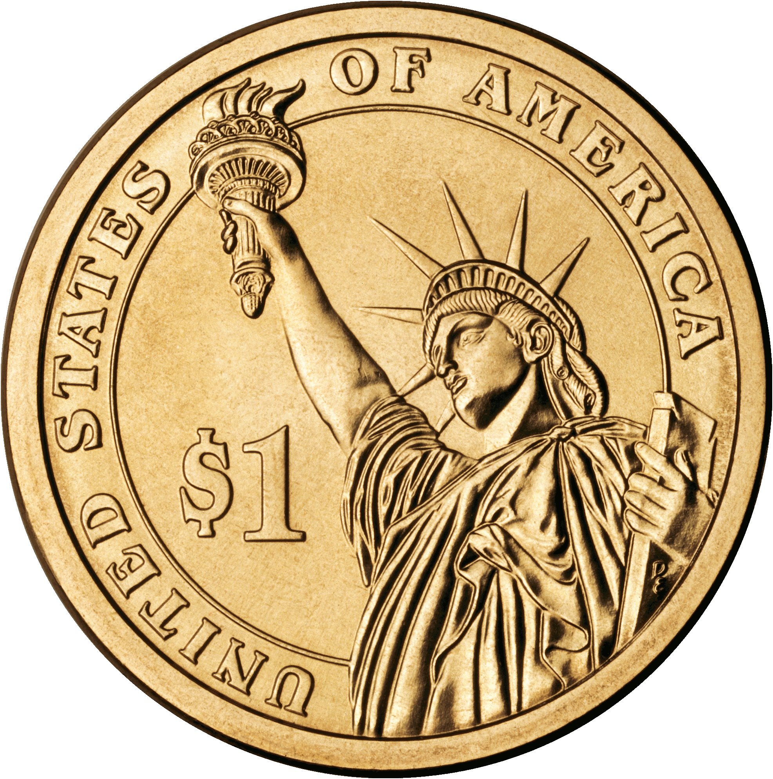
Project Overview
Main Objectives:
Accepts Nickels, Dimes, Quarters, Half Dollar and Dollar coins
User can decide between 2 items
Water bottle is sold at 50 cents
Soda is sold at 1.00 dollar
The machine returns change

Slide 4
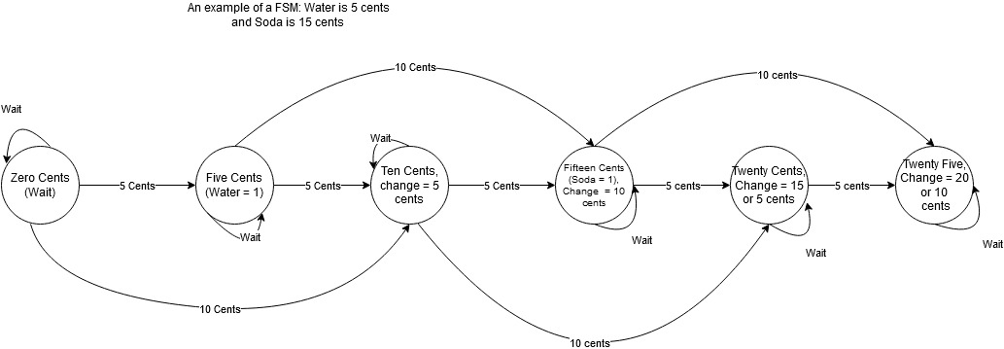
Design Process
Finite State Machine (Mealy)

Slide 5
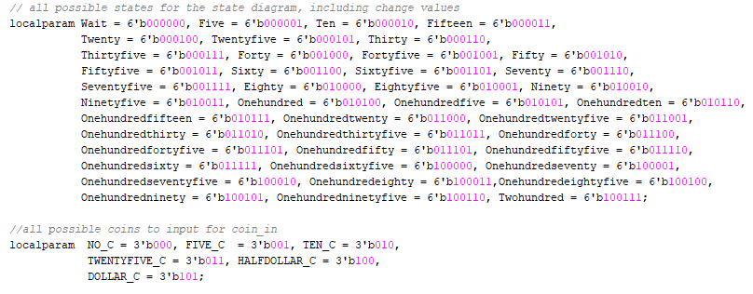
Design Process

Slide 6
Design Process
3 always blocks
Next state logic
Combinational logic
Determines change
Determines product to dispense
Sequential circuit
Updates logic

Slide 7
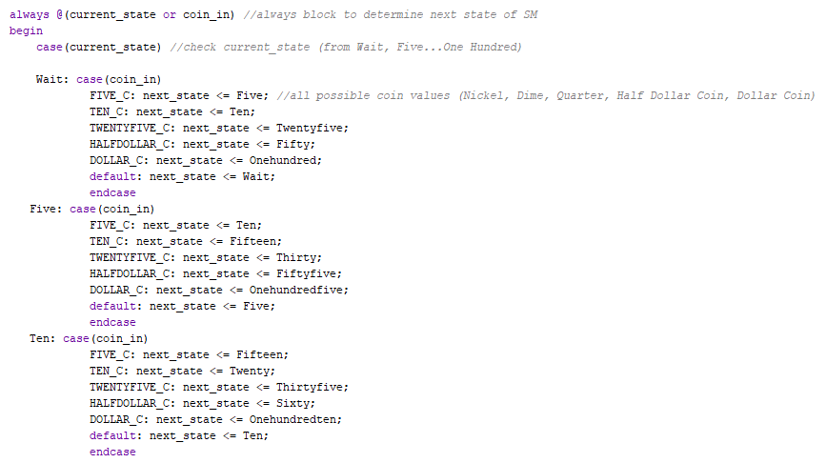
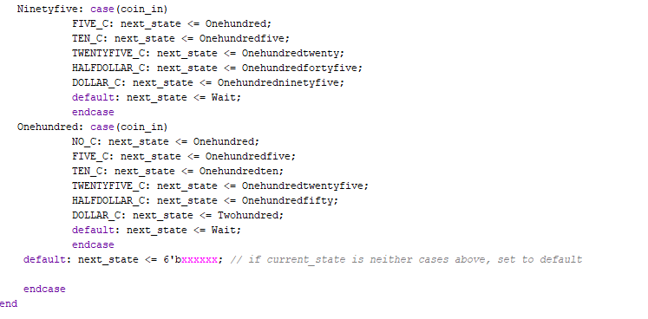
Design Process

Slide 8
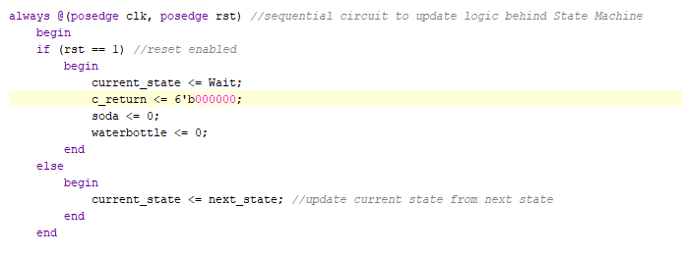
Design Process

Slide 9
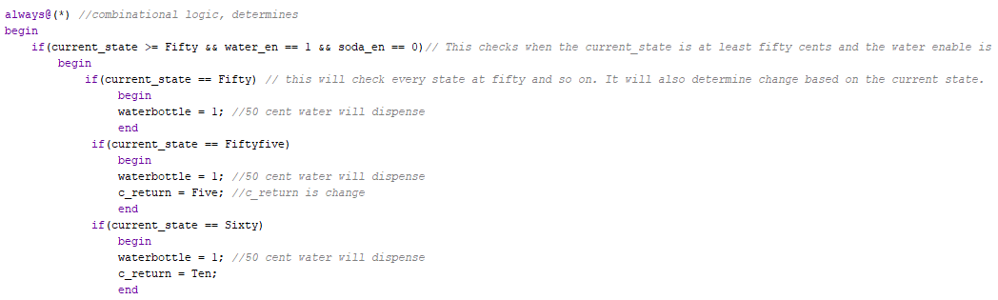
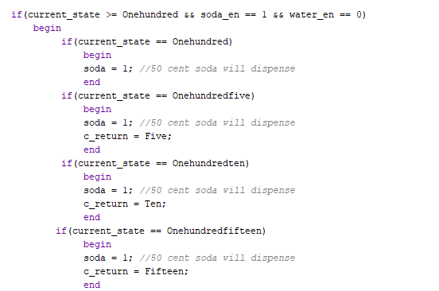
Design Process

Slide 10
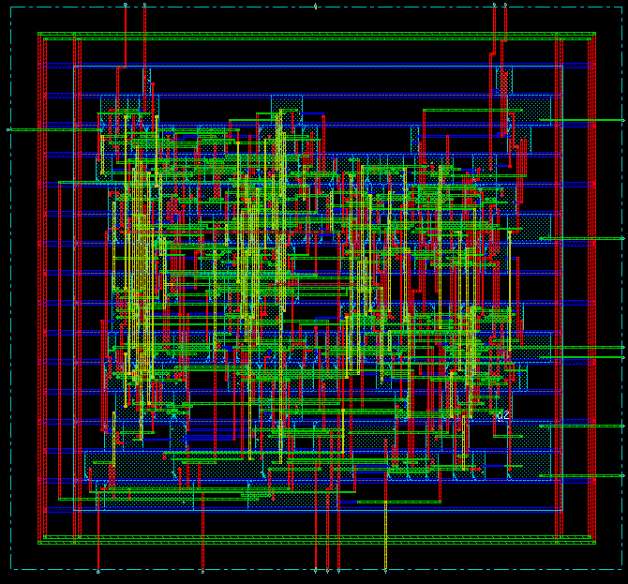
Tools & Methodology
Xilinx Vivado
Source Code
Testbench
Simulation Waveform
Schematic
Synthesis
Cadence Encounter
Mapping & Routing
GDS2/OASIS

Slide 11
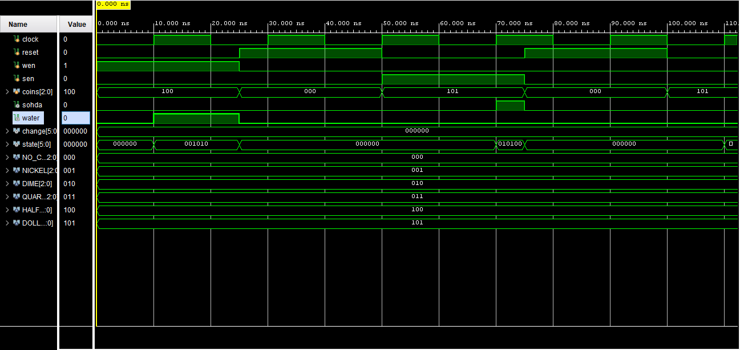
Results and Discussion
Xilinx Vivado

Slide 12
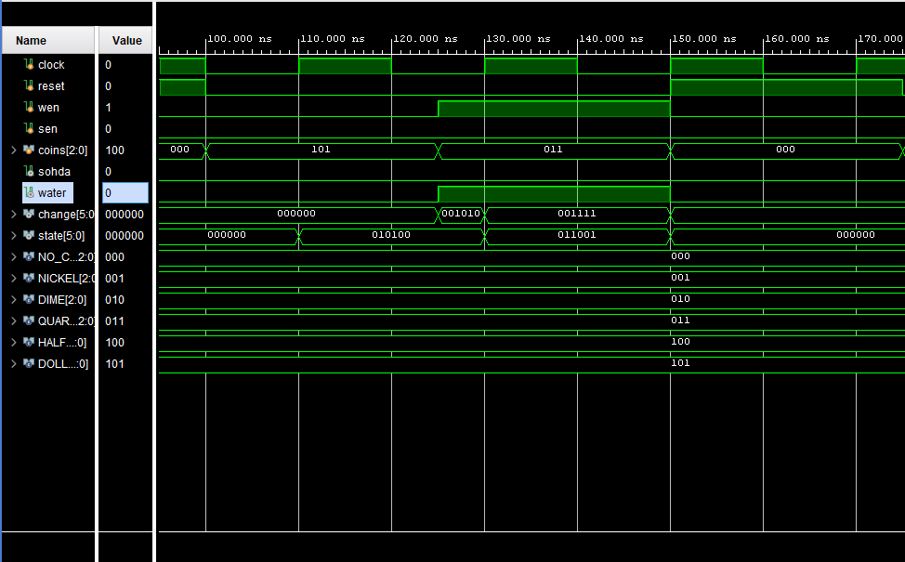
Results and Discussion

Slide 13
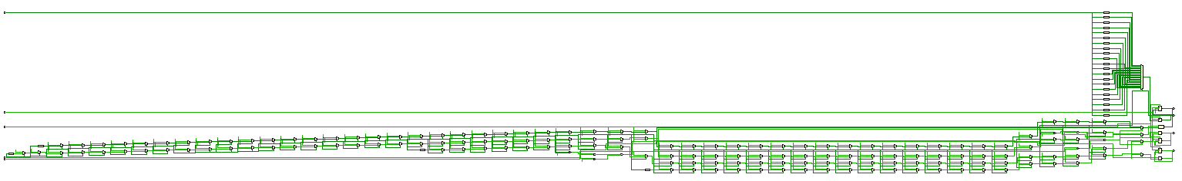
Results and Discussion

Slide 14
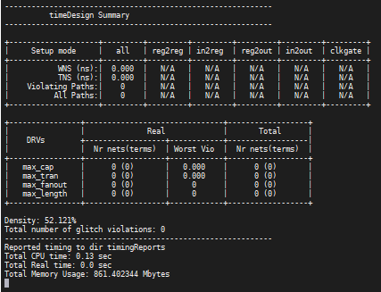
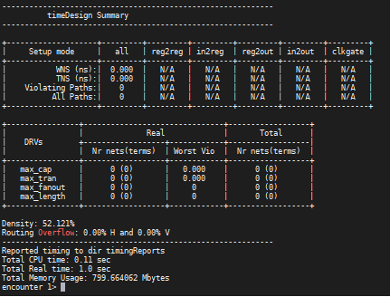
Results and Discussion
Cadence Encounter

Slide 15
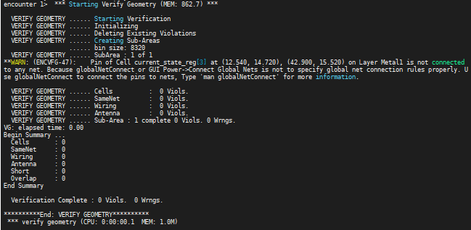
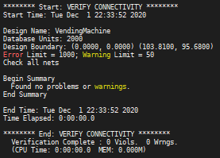
Results and Discussion

Slide 16
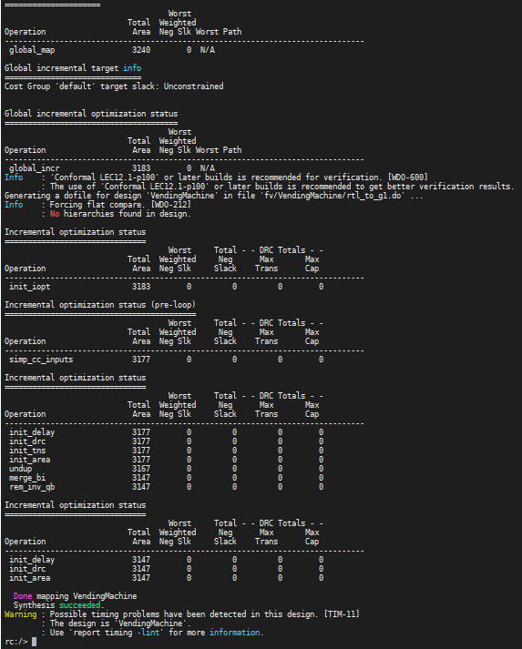
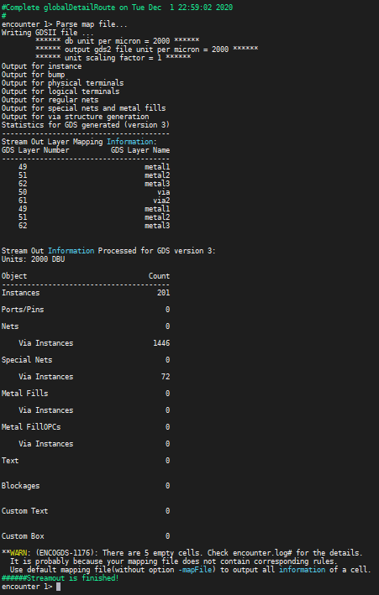
Results and Discussion

Slide 17
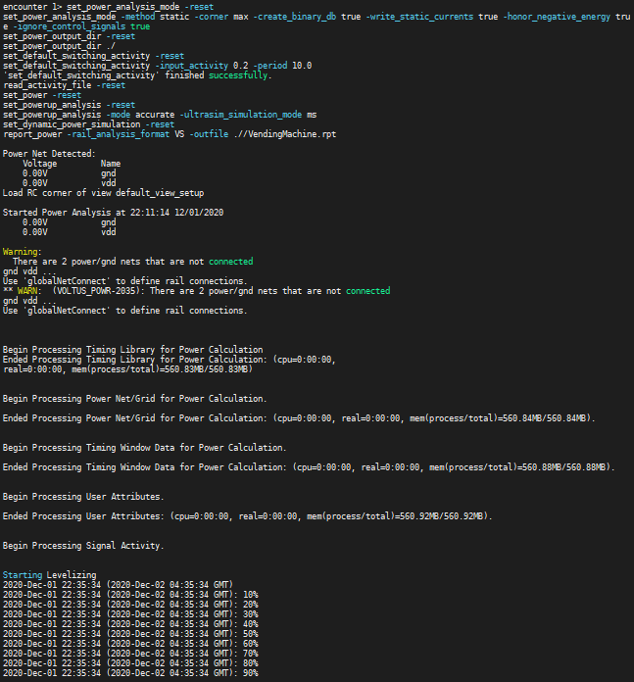
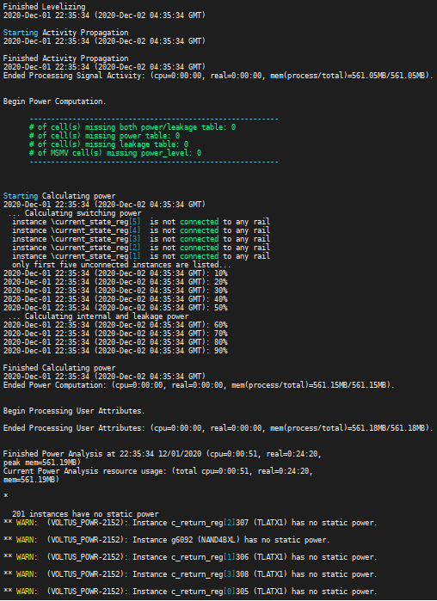
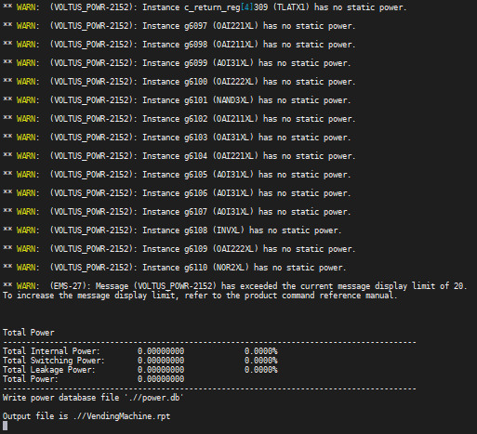
Results and Discussion

Slide 18
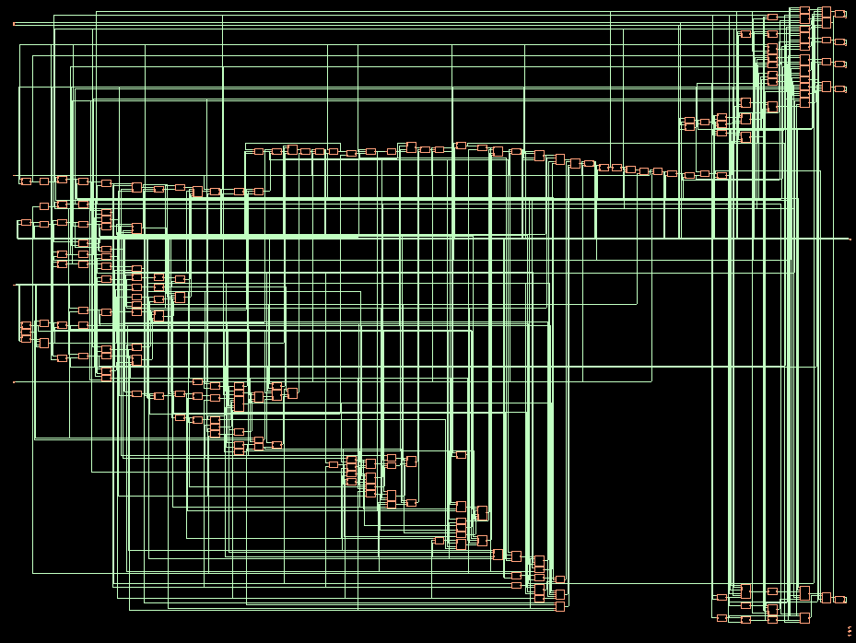
Results and Discussion

Slide 19
Conclusion
Vending Machine is operational
Some timing issues presented in Vivado
Constraints
Coin Denominations
Max coin insert amount is 2 dollars
Only dispenses 2 items

Slide 20
References
Youtube.com
ASIC-World.com
Labs from this course (EE4513)

Slide 21
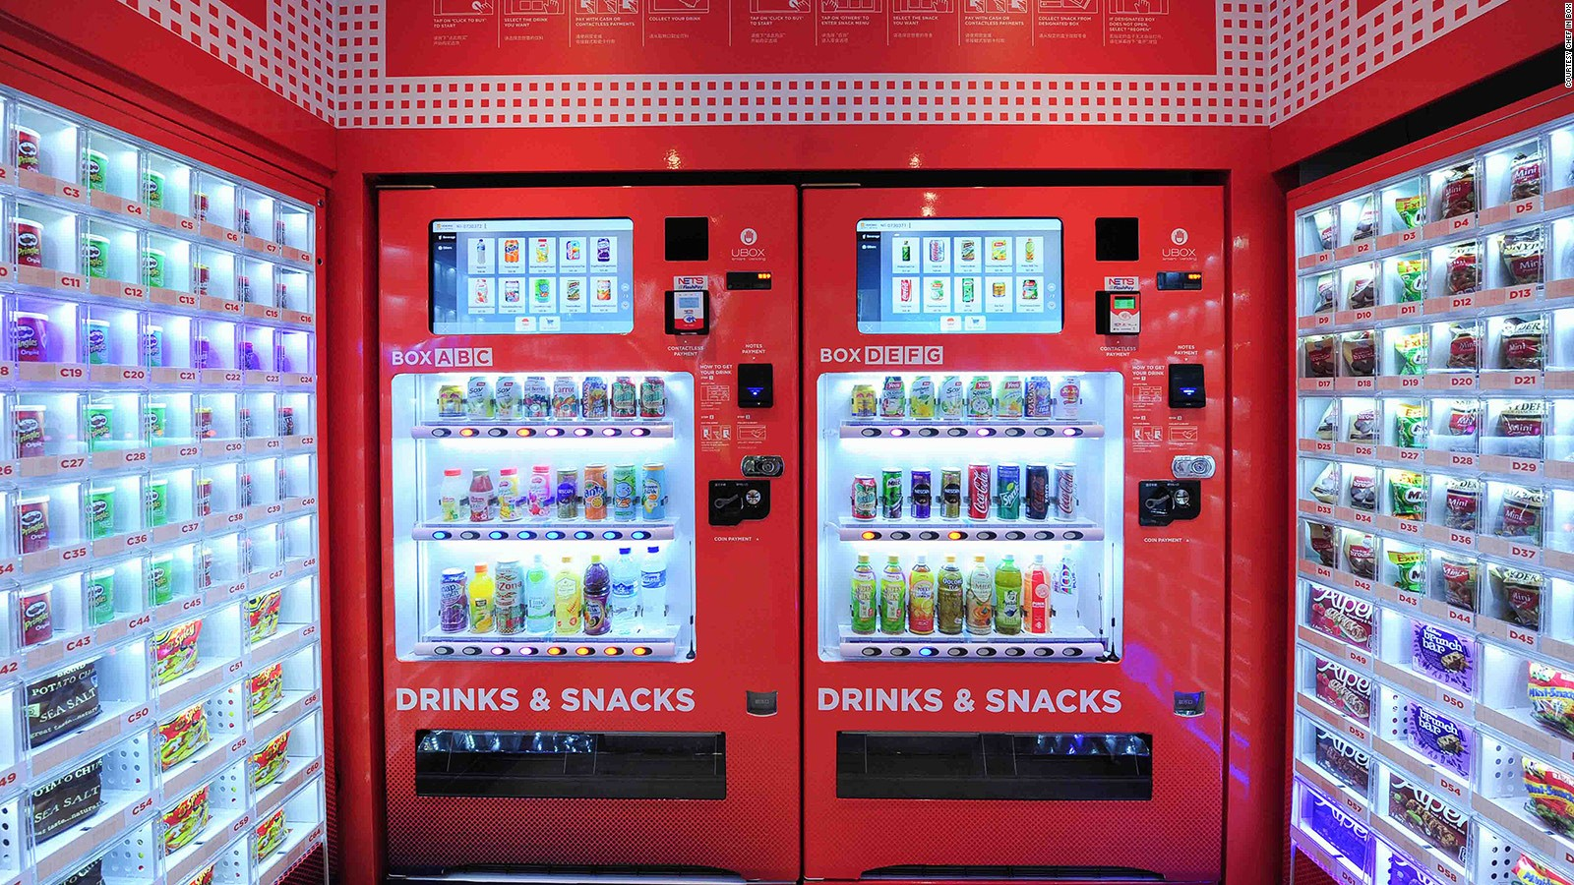


Questions?

